Slide 1
MM0013 – Material Requriement Planning
Overview of MRP

Slide 2

Workshop Ground Rules
Cell phones off
Full attention throughout
Scheduled Breaks only

Slide 3
Material Requirement Planning
PrepareMe
1
2
TellMe
3
ShowMe
4
LetMe
5
HelpMe

Slide 4
Consumption Based Planning
PrepareMe
1
2
TellMe
3
ShowMe
4
LetMe
5
HelpMe

Slide 5

Consumption based Planning
The Central role of Consumption based Planning is to monitor the stocks and automatically created the procurement proposals for purchasing and production
CBP are simple planning procedures which can be used in areas where there is no In-house production and/or in production plants for planning of both B & C parts and operating supplies
CBP triggers the requirement when stock falls below a predefined Reorder point or forecasting the requirements by using statistical procedures, taking in to account the past consumption values

Slide 6

Use
Useful for Simple Planning in areas without having In-house production.
Periodically updates the Safety Stock and Reorder point based on past consumption thereby resulting in Inventory Control.
Useful for planning high consumption, low value items.
Consumption
Based
Planning
Ensuring smooth flow of business by procuring material well before they are below danger level.

Slide 7
Challenge
To maintain Stock Accuracy so as to get more precise results from Consumption Based Planning
To maintain high level of Past Consumption data which is very essential to forecast future requirements
To monitor and update Master data relevant for Consumption based planning at regular intervals
Identifying materials to maintain safety stock and Reorder level

Slide 8
Consumption Based Planning
PrepareMe
1
2
TellMe
3
ShowMe
4
LetMe
5
HelpMe

Slide 9

MRP – Procedure Overview
MRP Procedures
Consumption based
Planning
MRP
Reorder point
planning
Forecast-based
planning
Time-phased
planning
Manual Reorder
point
Automatic
Reorder point

Slide 10
MRP - Determination of Material Req
MRP procedure is to ensure material availability i.e. to procure the requirement quantities for in-house production and for sale on time.
MRP
SD receives customer requirement and demand management plans sales using Sales Forecast. The resulting independent requirements trigger MRP.
Consumption based Planning
Consumption based planning is basically triggered by:
  Reorder Point Planning: Requirement triggers when the available stock level falls below the reorder point determined for the material. Two types:
      Manual Reorder point
      Automatic Reorder point
  Forecast based Planning: Historical data is used in the material forecast to estimate future requirements.
  Time phased planning: Historical data is used in the material forecast to estimate future requirements, but planning is only executed at predefined intervals.

Slide 11
MRP vs Consumption based Planning
MRP
Consumption
based Planning
MPR Planning are based on current and future sales
In MRP, the requirement elements are Sales order, planned independent requirement, material reservation
MRP is especially useful for planning of finished goods and important assemblies and components
CBP is based on historical data and uses material forecasts or statistical procedures to determine future requirements
CBP is triggered by the stock level falling below the Reorder Point or by Forecast requirement calculated from historical data
CBP is preferably used is areas without In-house production or to Plan B or C materials and operating supplies

Slide 12
CBP – MRP Type
MRP Type
MRP Type is the key that determines whether and how the Material is Planned
It controls:
  MRP Procedures (Type of Planning)
  whether Forecast Values need to be considered in MRP
  calculation of Safety Stock (manually/automatically)
  Screen Sequence for the display of header details in the Planning run
MRP Type is maintained in the Material Master MRP – 1 view

Slide 13
Special Procurement Type
Sp Procurement
Type
Special Procurement Type helps to override the Procurement type defined in the Material Master or helps in defining the Procurement type more precisely
Special Procurement Type are maintained at Plant Level
It controls
  Type of Procurement (Internal or External)
  Whether the Procurement is Consignment, Subcontracting….
  The behavior of BOM
  Whether the material can be directly consumed for Production or for other
  consumption

Slide 14

MRP Controller
MRP Controller is a person or group of person responsible for Material Planning for a material
MRP Controller is used to various reporting. Example: Planning results can be checked per MRP Controller
Material relevant for planning must be assigned to an MRP Controller
MRP Controller contains the details like the Telephone Number

Slide 15

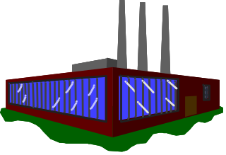
MRP Area
MRP AREA
Plant
Storage Location
Subcontracting
MRP Area represents an organizational unit which carries out MRP independently. The results of planning run are displayed specifically for each MRP Area
MRP Area enables a differentiation of MRP with in a Plant
MRP Area includes several Plant, Storage Locations of a Plant, or Stock with in a subcontracting
Notes:
There are three types of MRP areas:
1. Plant MRP areas (obligatory) that are automatically created by activating planning with MRP areas. Their numbers match the number of the plant. If no more MRP areas are defined, the plant MRP area covers the entire plant.
2. Storage location MRP areas that are defined by the storage locations assigned to them.
3. Subcontractor MRP areas that provide planning of the requirement of the material provided for a subcontractor, and are defined by the assignment of this subcontractor.

Slide 16
Lot-Size
Lot-sizing procedures
Static
Periodic
procedure
procedure
Lot-for-lot order quantity
Daily lot size
Fixed lot size
Weekly lot size
Replenish to
Monthly lot size
maximum stock level
Planning calendar
Lot Size procedure helps to calculate the Purchase Order and Production Quantities.
Different Lot Size can be maintained for different period through Short – Term and Long – Term Lot size.
Notes:
In Static Lot – size, future shortages are taking into account. When a shortage occurs, an order proposal is created for the amount defined for the static lot size. The system does not check to see when a future shortage will occur.
In periodic lot-sizing procedures, the system groups several requirement quantities within a time interval together to form a lot. The period lengths can be either days, weeks, months or a period of flexible length equal to posting periods as well as freely definable periods according to a planning calendar.
By using Rounding Profile, Lot – Size procedure can be further controlled. By specifying Rounding Value in the Material Master, system will determine during Lot - Size calculation that the lot size quantity is a multiple of an order unit. Example: pallet size, if the material is only delivered in complete pallets.
The minimum and maximum quantity for the purchase of a material can be fixed by stating the Lot size in the material records.

Slide 17
Consumption based Planning
Time - phased Planning
Forecast based Planning
Reorder Point Planning
Manual
Automatic
Notes:
Reorder Point Planning
In the reorder point planning procedure, the system compares available warehouse stock at plant level with the reorder level. If stock falls below the reorder level, the system generates an order proposal. If, however, a purchase order or a production order covering the required quantity has already been planned by purchasing or production, then the system will not create another one.
The following characteristics are important for defining the Reorder Point Planning
Safety Stock
Average Consumption
Replenishment lead time
Manual Reorder Point Planning: The Reorder Planning and Safety Stocks are maintained manually in the Material Master
Automatic Reorder Point Planning: The Reorder level and Safety stocks are calculated automatically based on the past consumption.
Forecast based Planning
Forecast based planning operates using historical values and forecast values and future requirements via the integrated forecasting program. These values forms the basis of the planning run, therefore have a direct effect in MRP.
The forecast, which calculates future requirements using historical data, is carried out at regular intervals. This offers the advantage that requirements, which are automatically determined, are continually adapted to suit current consumption needs.
Time phased Planning
If a vendor always delivers a material on a particular day of the week, it makes sense to plan this material according to the same cycle in which it is delivered, but displaced by the delivery time.

Slide 18
Consumption based Planning
Time Phased Planning
This type of planning is useful in case when the delivery of a material is fixed on a particular day of a week
The planning date for the material is pre-set during creation of material record and it is re-set after every procurement
This type of planning does not provide the flexibility of automatically varying the planned purchase date with variation in the requirement. Manual change is required to change the planned purchase element (purchase requirement etc.)
Forecast Based Planning
This planning is based on the consumption pattern of a material. Past record of consumption of material forms the basis of this planning
Proper and precise records of inventory and production, is a per-requisite for this planning
The value from Forecast based planning (value of purchase element created) keeps updating with the consumption of material in planned period

Slide 19
Reorder Point Planning
In Reorder Point the proposal for procurement is made when the Plant stock of the raw material falls below a predefined limit
The time required to receive the material after placing the order to the vendor is taken into consideration for this planning
Purchase Orders, planned order, firmed purchase requisition those are due for execution in the replenishment period (time between reorder point and the safety stock) forms a crucial part of the reorder point planning
Manual Reorder Point:
In Manual Reorder Point the Reorder Level & the Safety stock are maintained manually in the Material Master
Automatic Reorder Point
In Automatic Reorder Point, the past consumption data is used to calculate the reorder level and the safety stock level
The Service Level maintained in the MRP Controller and materials replenishment lead time is taken into account while calculating the Reorder Point

Slide 20
Consumption Based Planning
PrepareMe
1
2
TellMe
3
ShowMe
4
LetMe
5
HelpMe

Slide 21
Agenda
Material Master
MRP Group
MRP Type
MRP Profile
Reorder based Planning
Forecast based Planning
Time phased Planning
Lot Size
Planning Run

Slide 22
Material Master
MRP Group
MRP Type
MRP Profile
Reorder based Planning
Forecast based Planning
Time phased Planning
Lot Size
Planning Run

Slide 23
MRP data in Material Master
Procurement Data
MRP Data
Accounting Data
MRP Type
Planned Delivery Time
Lot size Indicator
MRP Controller
Scheduling Margin Key
Procurement Type
Purchasing group
Goods receipt
processing time
Valuation Class
Valuation Procedure
Valuation Price
Storage Loc Data
Forecast Data
MRP Indicator
Special procurement
type S Loc
Consumption Data
Notes:
MRP Data in the material master has been subdivided in to following categories:
General Data which contains the Material Code, Material description and Unit of measure
Data required for Scheduling
Data dependent on MRP procedure
Data required for Lot-size calculation
Procurement type
Procurement Type – whether material is procured In-house or Externally
Procurement Data contains
Purchasing Group which is required for External Procurement
Goods receipt processing time which is required for calculating the lead time during the MRP run.
Accounting Data contains
Valuation Class details
Valuation Procedure and Valuation Price details.

Slide 24
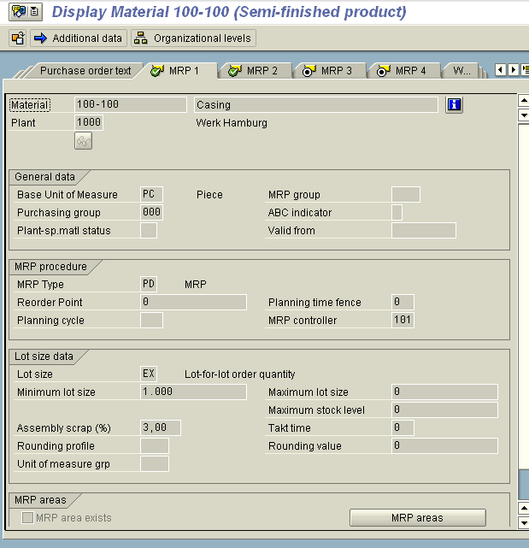
MRP data in Material Master
MRP – 1
MRP Grp are maintained at Plant level and controls the Strategy Group, the consumption mode and the Planning Horizon
MRP Type controls whether to have:
Manual Reorder Point
Automatic Reorder Point
Forecast based Planning
Master Production
Scheduling
Notes:
In the MRP – View you maintain
Plant Specific Material Status: It controls the use of a material in a particular Plant. Example: Blocked for Procurement/Warehouse, Blocked for Purchasing, Obsolete Material…
You can also maintain a Validity period of the Plant Specific Material Status
ABC Indicator: It categories the Material into A Class, B Class & C Class item. This classification process helps in ABC Analysis
Reorder Point: It contains the Reorder quantity. If the stock falls below the Reorder quantity then the system flags the material for Requirement planning by creating a Planning file entry. Maintaining Value in this field only makes sense when the Reorder Point Planning is used. The Reorder quantity can be either entered manually or system calculates it automatically
Planning Cycle: Planning Cycle is the key that determines the day on which the material is planned and ordered
Lot size: It is the key that determines which lot-sizing procedure the system uses within materials planning to calculate the quantity to be procured or produced. You can also maintain Minimum & Maximum Lot size which will considered at the time of Planning run

Slide 25
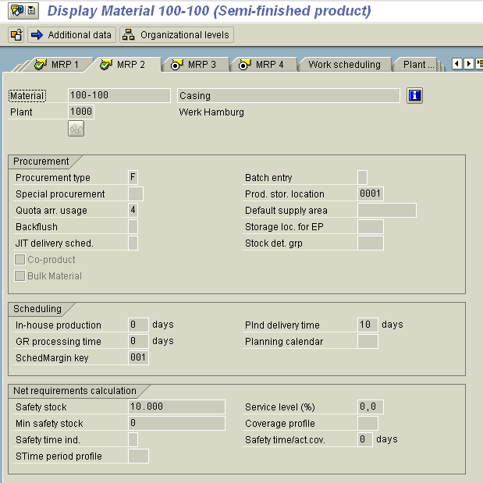
MRP data in Material Master
MRP – 2
In MRP – 2 View you maintain:
Procurement Type
Special Procurement Type
Quota Arrangement Usage
Prod Storage Location
Procurement Storage Loc
Scheduling details
Net requirement calculations
Notes:
MRP – 2 maintains:
Procurement Type controls whether the Material is In-house Produced, Externally Produced or both. Depending on this settings, Production Order or Purchase Requisition is created during MRP run
Special Procurement type controls the procurement process more precisely. It controls whether with the Procurement type, the material is a Consignment, Sub contracting, Stock Transfer, etc
The Storage location maintained in the field “Production Storage Loc” get default copied in the Planned order and Production order. It makes sense to update this field when the Procurement is In-house Production
The Storage location maintained in the field “Storage Loc for EP” get default copied in the Purchase Requisition. It makes sense to update this field when the Procurement is Externally Produced
You can maintain the lead time (in days) required for In-house production, GR processing, Delivery time. These days are considered during the MRP run
You can maintain Safety stock in order to satisfy unexpectedly high demand in the coverage period.

Slide 26
Agenda
Material Master
MRP Group
MRP Type
MRP Profile
Reorder based Planning
Forecast based Planning
Time phased Planning
Lot Size
Planning Run

Slide 27
MRP Group
Control PR Creation
Control S Line Creation
  Creation of MRP List
P
L
A
N
T
MRP Grp - 1
Procurement Control
MRP Grp - 1
Consumption Mode
MRP Grp - 1
Checking Rule
MRP Interval
Planning Time Fence
Notes:
The MRP group contains all the materials from the point of view of MRP for assigning special control parameters for the total planning run. MRP Group are Plant Specific
MRP Group controls whether the Purchase Requisition or Planned order needs to be created for the total Planning horizon.
It also controls whether Schedule lines should be created in the Planning horizon or not.
It controls whether a MRP list should be created or not.

Slide 28
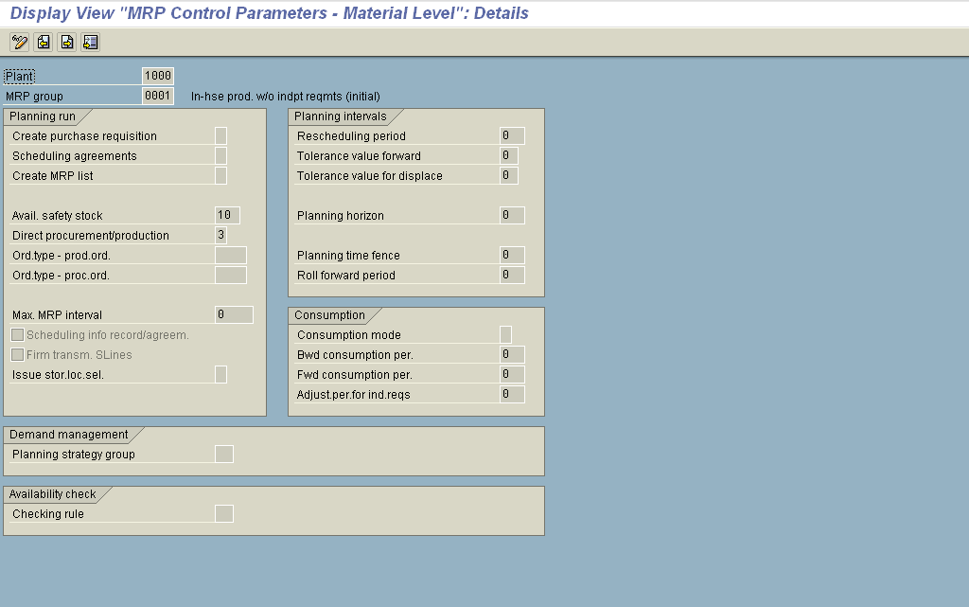
MRP Group
SPRO → Materials Management → Consumption based Planning →
MRP Groups

Slide 29
Agenda
Material Master
MRP Group
MRP Type
MRP Profile
Reorder based Planning
Forecast based Planning
Time phased Planning
Lot Size
Planning Run

Slide 30
MRP Types
Safety/Reorder Point Stock
MRP Procedures
Firming Type
MRP type
MRP on regular basis
Forecast Usage
Screen Sequence
Notes:
MRP Type is the key that controls the MRP procedure to be used for the planning of material
MRP Type controls which planning parameters must or can be entered when maintaining the Material Master record
MRP Procedure maintained in MRP Type controls the planning of Material. Example: Whether Material should be planned with Reorder based planning, MRP, Forecast based planning
It also controls whether to consider Forecast results
It also controls whether to calculate the Safety stock and Reorder point automatically
It controls the screen sequence for the display of the header details in the evaluation of Planning run

Slide 31
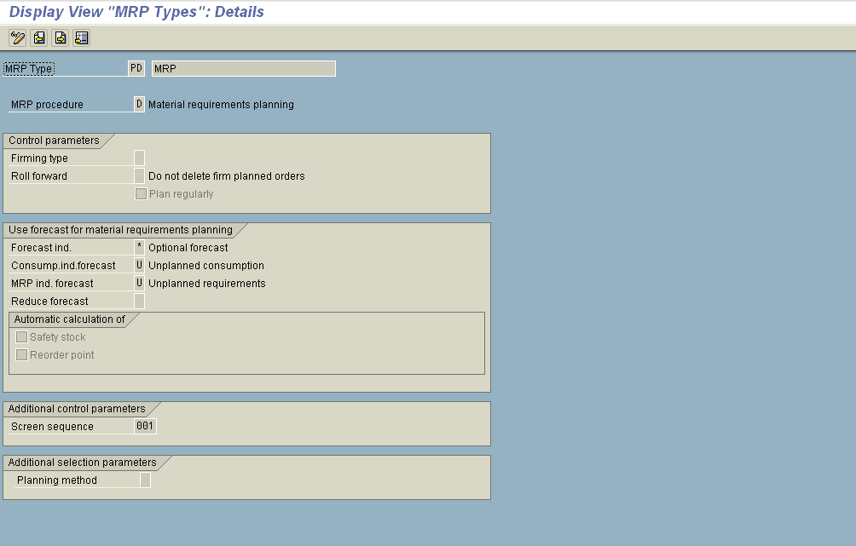
MRP Type
SPRO → Materials Management → Consumption based Planning →
Master data → Check MRP Type

Slide 32
Agenda
Material Master
MRP Group
MRP Type
MRP Profile
Reorder based Planning
Forecast based Planning
Time phased Planning
Lot Size
Planning Run

Slide 33
MRP Profile
MRP
PROFILE
Standard Values
MRP Type
MRP Grp
MRP Controller
Procurement Type
Sp Procurement Type
Lot Size
Prod Storage Location
Purchasing Group
Default Values
Safety Stock
Reorder Point
Plnd Delivery time
In-house Prodn
Min Safety Stock
Notes:
MRP Profile helps in storing MRP parameters that do not depend on the Material Master. The information contained in the Profile is standard information which is needed again and again when maintaining Material Master records. Thus MRP Profiles simplifies the maintenance of administration data
MRP Profile also help to make a key fields write protected that by controlling the authorization issues. The values in write protected fields need to maintained in the MRP Profile
MRP Profile also helps in the listing the Material Master records that use the same MRP Profile.

Slide 34
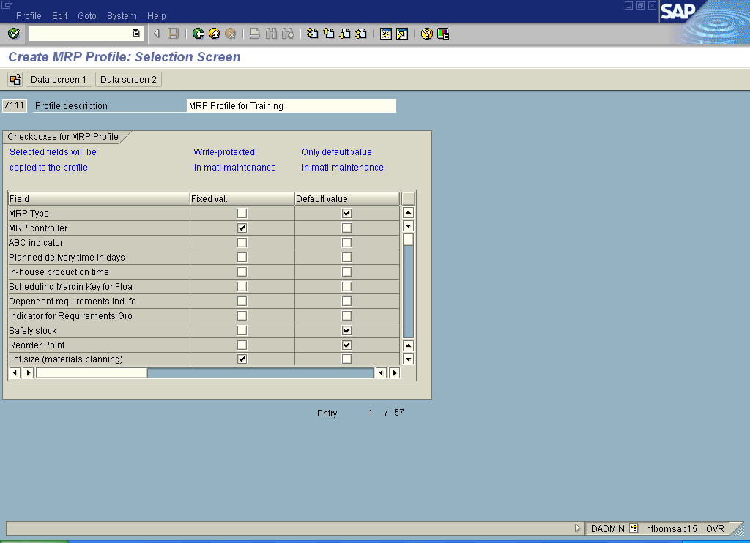
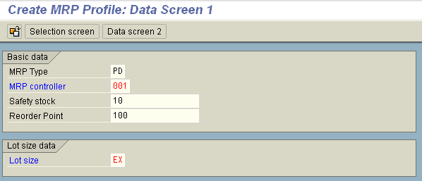
MRP Profile
Transaction Code:
MMD1: Create
MMD2: Change
MMD6: Change
MMD3: Display
MMD7: Usage
Notes:
When an existing MRP Profile is changed, system creates a background job to update all the Material Masters which are already created with the changed profile.

Slide 35
Agenda
Material Master
MRP Group
MRP Type
MRP Profile
Reorder based Planning
Forecast based Planning
Time phased Planning
Lot Size
Planning Run

Slide 36
Reorder Point Planning
Stock
Lot size
Reorder
point
Safety
stock
Release date
Availability
Time
date
Replenishment
lead time
System keeps a continuous check on the stock level. Whenever a material is issued from the warehouse, system checks for the level of stock. If the Total Stock falls below the reorder level, system generates an entry in the planning file for the next MRP run
In case of return material, the system checks whether the available warehouse stock exceeds the reorder level again. If this is the case, an entry is made in the planning file, which acts as an indicator for the planning run to delete any unnecessary procurement proposals
Notes:
Once the requirement is triggered, system calculates the Procurement quantity by taking into consideration the “Lot size” if any maintained in the Material Master
For Reorder Point Planning the system supports the “Fixed Lot size” and “Replenish up to maximum stock level” lot sizing procedure
“Optimum lot-sizing procedures” can also be used for Reorder Point Planning. In this case, you must calculate future requirements using the forecasting functions. The forecast values are then interpreted as requirements
MRP Types controls whether the Reorder Point needs to be determined automatically

Slide 37
Net Requirement Calculation –
Reorder Point Planning
Stock
+
<
Procurement
Proposal
(Lot Size)
Firmed Planned Ord
Firmed PR
Reorder
Point
When
Triggers
+
Purchase Order
Notes:
In reorder point planning, the available warehouse stock is a result of the following calculation: Warehouse stock + open purchase order quantity (purchase orders, firmed planned orders, firmed purchase requisitions)
There will be a material shortage if the available warehouse stock is less than the reorder point
The shortage quantity is the difference between the reorder point and the available warehouse stock. The purchase order quantity is created from the lot-sizing procedure in the material master record

Slide 38
Forward Scheduling for External Procurement
When the stock falls the reorder point, procurement start immediately. Forward scheduling means defining the date on which the material will be available from the date of Planning run
Forward Scheduling starts from the current date. It specifies the order start date for Planned orders and PR release date
Forward Scheduling considers Purchasing Department processing time, Goods receipt processing time
Purchasing Department processing time, is the time available for buyer to convert a Purchase Requisition to Purchase Order
Goods receipt processing time, is the time between the receipt of material and the addition to stock

Slide 39
Agenda
Material Master
MRP Group
MRP Type
MRP Profile
Reorder based Planning
Forecast based Planning
Time phased Planning
Lot Size
Planning Run

Slide 40

Forecast based Planning
This planning method takes the historical values into consideration to generate the requirements for the future. The forecast values are determined via an integrated program. In contrary to re-order point planning strategy, the value generated by forecast based planning forms a part of the planning profile during the MRP run.
Calculation for the future requirements is carried at regular interval. This results in continual adaptation to suit the current consumption requirements. The change in the forecast requirements is based on the average daily consumption and not on actual consumption.
Notes:
MRP Type controls the Forecast based Planning
In Forecast Planning, system copies the requirements quantities that it has forecast in the requirements planning run and calculates net requirements. During this calculation, every period is checked to make sure that the forecast requirements are covered either by available stock, by planned receipts from purchasing or by production. If a material shortage occurs, the system generates a procurement proposal
The system calculates the quantity recorded in the procurement proposal according to the lot-sizing procedure that you specified in the material master. Depending on the lot-sizing procedure, several forecast requirements are grouped together into one lot
For every procurement proposal, the system calculates the date on which it must be converted into a purchase order or a production order

Slide 41
Forecast based Planning
The system calculates the average daily requirement is calculated using formula:
Forecast requirement
Number of days in forecast period
Reduction in forecast requirements is done by formula :
Number of workdays worked X av. Daily requirements

Slide 42
Agenda
Material Master
MRP Group
MRP Type
MRP Profile
Reorder based Planning
Forecast based Planning
Time phased Planning
Lot Size
Planning Run

Slide 43

Time Phased Planning
This type of planning is useful in case when the delivery of a material is fixed on a particular day of a week.
The planning date for the material is pre-set during creation of material record and it is re-set after every procurement.
This type of planning does not provide the flexibility of automatically varying the planned purchase date with variation in the requirement. Manual change is required to change the planned purchase element (purchase requirement etc.)

Slide 44
Time Phased Planning
Settings
Maintain MRP Type (R1, R2) in the Material Master MRP – 1 View
Maintain Planning Cycle in the Material Master MRP – 1 View. Planning cycle is a Planning calendar which determines the day on which the material is planned and ordered
Entered “lot-for-lot order quantity” as the MRP lot size (MRP 1 view). Optimum Lot size can also be used for Time phased planning
Process Flow
In Time Phased Planning, system checks the MRP data in the planning file to calculate the actual planning for the material. The Planning date is calculated using the Planning cycle
The system determines the Time Interval taking into account all the requirements up to next MRP date including the delivery time. The Net requirement for the system is minus of stock and firm receipts.
Notes:
Formula followed by the system to calculate Time Phased Planning:
Actual Requirements = Forecast Requirements – Other requirements in the time interval + Safety Stock.
Time Interval = Planning Cycle + Purchase Processing Time + Planned Delivery Time + Goods Receipt Processing Time.

Slide 45


Time-Phased Planning Process with delivery cycle
If there exists a limitation on the delivery date( a particular day of week or month) of material by the Vendor, then SAP provides integration of Time-Phased Planning with Delivery Cycle. This is an important functionality of SAP Retail System. Here the system proposes the delivery cycle from vendor sub-range while creation of material master
{Vendor Sub-range is the list of material supplied by a vendor, that can be grouped together for logistic point of view}
Prerequisite: In MRP-2 view of material Master, planning calendar is defined as delivery cycle in addition to the planning cycle
Notes:
Example for Time Phased Planning Process with delivery cycle:
If you start the planning run, the system uses the MRP date recorded in the planning file to check which materials are actually to be planned. The system calculates requirements independently from that, whether you have entered a delivery cycle or not
The system uses the time interval between the MRP date and the availability date for the next MRP date as a basis for calculating the requirements quantity. It also takes for granted that the vendor requires at least the planned delivery time the planned delivery time before he can deliver his goods
This means the following (if no goods receipt processing time has been maintained):
If the MRP date is a Monday, the interval used for the calculation is from Monday to Friday, as the Friday is the goods receipt date of the next MRP date (Tuesday)
If the MRP date is a Tuesday, the interval used for the calculation is from Tuesday to the Wednesday of the following week, as the Wednesday is the goods receipt date of the next MRP date (Monday)
The material's stocks (stock plus firmed receipts in the interval) must cover this interval. If a material shortage occurs, the system creates a new procurement proposal
The system interprets the planned delivery time as the ‘minimum delivery time’. That is, it takes at least this number of days for the goods to be delivered from the time that the order was placed. Thus, the system recognizes in the example above that if the planning run is carried out on Tuesday, the material will not be delivered until Friday and not on Wednesday

Slide 46
Agenda
Material Master
MRP Group
MRP Type
MRP Profile
Reorder based Planning
Forecast based Planning
Time phased Planning
Lot Size
Planning Run

Slide 47
Lot – Size: Static Lot Sizing
Static Lot Sizing
Procedure
Lot-for-lot order
Fixed Lot Size
Repl to max stock
Quantity
Time
In Static Lot size Procedure future shortages are taken into account. If a shortage occurs, an order proposals is created for the amount defined for the static lot size.
Notes:
Lot-for-lot-order:
The system uses the exact shortage quantity (requirement minus available stock) as the order quantity in the case of a material shortage.
The indicator “EX” is maintained in the Material Master – MRP View 1 for Lot for lot order.
Fixed Lot Size:
This is useful when material is delivered in a fixed lot size. Example: Pallets of a certain quantity, tanks of a certain size
When planning using fixed lot size, the system will use the fixed order quantity recorded in the material master for the lot-size calculation if a material shortage exists. If the fixed lot size is not sufficient to balance out the material shortage, then several lots are planned for the same date until the material shortage is eliminated
The indicator “FX” is maintained in the Material Master – MRP View 1 for Fixed Lot Size
Replenishment up to Maximum Stock Limit:
Replenishment up to Maximum Stock Limit is used to fill the stock up to highest possible level
The system creates an order quantity to bring the stock level up to the maximum stock level. If, however, the requirements for one day are greater than the maximum stock level the system creates an order quantity for the required quantity. In this case, a balanced stock/requirements situation is given higher priority than the lot-sizing procedure
The indicator “HB” is maintained in the Material Master – MRP View 1 for Replenishment up to Maximum Stock Limit

Slide 48
Periodic Lot size Procedure
Quantity
Time
Period length
Period length
Day(s)
Receipts
Week(s)
Month(s)
Issues
Period according to
planning calendar
The system groups the requirement within the time interval together to form a Lot.
Example: for days, weeks, months….
Splitting and overlapping is also possible with Periodic Lot size procedure.
Notes:
In periodic lot-sizing procedures, the system groups several requirement quantities within a time interval together to form a lot. The period lengths can be either days, weeks, months or a period of flexible length equal to posting periods as well as freely definable periods according to a planning calendar.
Daily lot size: All requirement quantities that fall within a day or within a specific number of days (which you have determined) are grouped together to form a lot
Weekly lot size: All requirement quantities that fall within a week or within a specific number of weeks (which you have determined) are grouped together to form a lot
Monthly lot size: All requirement quantities that fall within a month or within a specific number of months (which you have determined) are grouped together to form a lot
Lot size according to flexible period length: All requirement quantities that fall within one flexible period length or within a specific number of flexible period lengths (which you have determined) are grouped together to form a lot. You determine the period lengths according to the accounting periods. This lot size is also called period lot size

Slide 49
Optimum Lot Size Procedure
The aim of optimum lot-sizing procedure is to group shortages together in such a way that costs are minimized. These costs include lot size independent costs (setup or order costs) and storage costs
Example:
If you order often, you will have low storage costs but high order costs due to the high number of orders. If you only seldom place orders then you will find that your order costs remain very low, but your storage costs will be very high since warehouse stock must be large enough to cover requirements for a much longer period
In Optimum Lot Size following procedures are available:
  Part Period Balancing
  Least Unit Cost Procedure
  Dynamic Lot Size Creation
  Groff Reorder Procedure

Slide 50
Lot Size – Other Key features
Lot Size with Splitting & Overlapping:
We can determine whether a fixed or period lot size is divided into partial quantities and that these are to be produced at regular intervals that overlap each other.
This lot-sizing procedure is very useful if the actual requirement quantities that occur in the period or the quantity to be produced for a certain date are very large but production is only laid out for smaller quantities.
Short Term & Long Term Lot Size
Short-term and a Long-term lot size can be maintained for a material. This results in splitting up the time axis for the material requirements planning into a Short-term and a Long-term area and thus carry out the procurement quantity calculation using two different lot-sizing procedures.
Lot-for-lot-order remaining Quantity
It helps in determining the lot-sizing procedure that the last lot of the planning run is always planned exactly. This prevents the procurement quantities exceeding the requirement quantities and thereby avoids high scrap cost.

Slide 51
Agenda
Material Master
MRP Group
MRP Type
MRP Profile
Reorder based Planning
Forecast based Planning
Time phased Planning
Lot Size
Planning Run

Slide 52
Planning Run
Requirements Planning for Plant – background processing
(Total Planning)
Requirement Planning for one Plant – Online Processing
(Total Planning)
Requirements Planning for Material – Online Processing
(Single-item Planning)
Notes:
When Planning is run as a total planning in one Plant, all the material in that Plant that are relevant for Planning are considered for Planning. It includes BOM explosion for BOM Materials
The total planning run can be carried out online or in the background processing mode. If Planning needs to run for several plants and/or MRP areas, use the scope of planning function. Scope of planning is defined in Customizing, by specifying its plant and MRP area
Planning run can also be executed for a single material as Single item Planning. In this case, the planning run is carried out for one particular material either single or multi-level. In single-level, single-item planning, the system only plans the BOM level of the selected material. In multi-level, single-item planning, the system plans the level of the selected material plus all the lower BOM levels

Slide 53
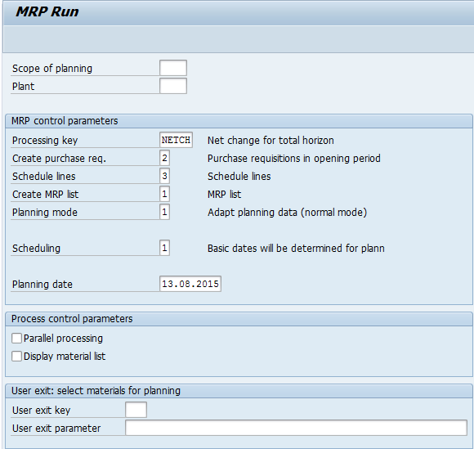
Planning Run – Online Plant
This field provides the option to club more then 1 MRP area or Plant for a Planning run
This field provides the option of controlling the selection of material for a planning run. With the use of User Exit a certain group of materials can be selected for MRP run.
This field provides additional flexibility in selection of materials for the planning run. For example, the materials to be considered can be sort on the basis of the MRP Controller.

Slide 54
Planning Run – Single Item
Flexibility of MRP for a material is controlled from this field. To make the Net Change Planning firm or changeable is controlled here.
The purchase element (Planned Order or Purchase Requisition) to be generated from MRP run is controlled from this field
Creation of Delivery Schedules to the vendor after MRP run, is controlled by this field. There exist some other dependencies for creation of delivery schedules.
This field controls the treatment for the procurement proposals from last planning run. Decision that whether system reactivates the un-firmed procurement proposals from last run or not.

Slide 55

Planning File
The planning file contains entries for all the materials in a plant relevant to planning, provided that MRP is activated for the plant
The planning file controls the planning run and the scope of the planning
When a change relevant to planning (for example, creation of a purchase order) occurs, a change indicator is set in the planning file for the respective entry (file entry NETCH). When a change relevant to planning occurs within the planning horizon, another change indicator is set (file entry NETPL)
Notes:
Changes relevant to planning can be:
Changes involving stocks, provided they change the stock/requirements situation of the material
The addition of purchase requisitions, purchase orders, planned orders, sales requirements, forecast requirements, dependent requirements, or reservations
Changes to fields relevant to planning of these goods receipts or issues, or of the material master record.The deletion of goods receipts or goods issues

Slide 56
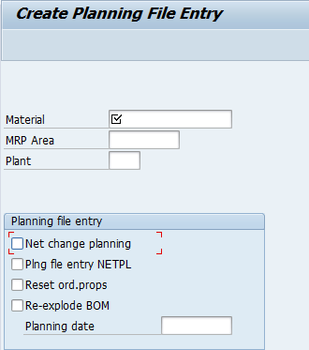
Planning File
This check box is relevant when a material needs to be considered for net change planning run.
For considering the material in short term planning horizon
It checks the relevance of procurement elements from last planning run in fresh planning run.

Slide 57
Agenda
Material Master
MRP Group
MRP Type
MRP Profile
Reorder based Planning
Forecast based Planning
Time phased Planning
Lot Size
Planning Run
Planning Evaluation

Slide 58

Planning Result
Planning File Entry
Planning Run
Procurement
Proposal
MRP
List
Notes:
The Planning Run creates update the MRP List and also generates Procurement Proposal
Procurement Proposal can be a Planned order, Purchase Requisition or a Schedule Line. This is controlled by the Creation Indicator in the Planning Run
Requirements planning can be carried out for various numbers of materials. The planning run type controls the scope of the materials to be planned

Slide 59


Evaluating the Planning Result
Planning Result
Evaluation
Stock Requirement
List
MRP LIST
Notes:
MRP List:
MRP List is created according to the settings in the Creation Indicator. These lists contain the planning result for the material. The MRP list always displays the stock/requirements situation at the time of the last planning run and it also provides a work basis for the MRP controller. Changes that are made after the planning date are not taken into consideration, so the list is static.
MRP lists are stored in the system until they are either deleted manually or replaced by new lists from a subsequent planning run.
Stock Requirement List:
The Stock Requirement List always displays the most up to date stock and requirement situation.
The main difference between the MRP list and the stock/requirements list is that each time the stock/requirements list is called up, the system selects the various MRP elements and displays the most up-to-date situation. You thus always see the current availability situation of the material in the stock/requirements list. Changes that are made after the planning date are displayed directly, so the list is therefore dynamic.
Stock/requirements lists are not saved in a fixed state in the system, but are subject to change and only exist in the working memory.

Slide 60
MRP List & Stock Requirement List
General structure
Current stock/
reqmnts
list
Variable
header
Planned orders
Purchase requisitions
current
current
Production orders
Purchase orders
...
Plant stock/
Storage location stock
MRP
Sales orders
MRP
Planned
ind
.
reqs
elements
elements
Planning
Selection tree
Planning
...
run
run
MRP list
Notes:
The basic structure of both lists is the same:
- Links (optional) are in the form of a tree in the MRP controller's work list
- At the top of the list is the header with the material number. The header details display more information
- The list itself contains the individual MRP elements and the corresponding available quantities
The current stock/requirements list is a dynamic list: It shows the present stock, requirements and receipts situation. Changes become obvious as soon as you call the current stock/requirements list, or choose Refresh to read the elements from the database in the display of the stock/requirements list
The MRP lists shows the result of the most recent planning run and is therefore static: Changes made after the planning run are not shown. You can decide in the planning run, whether a MRP list is to be created

Slide 61
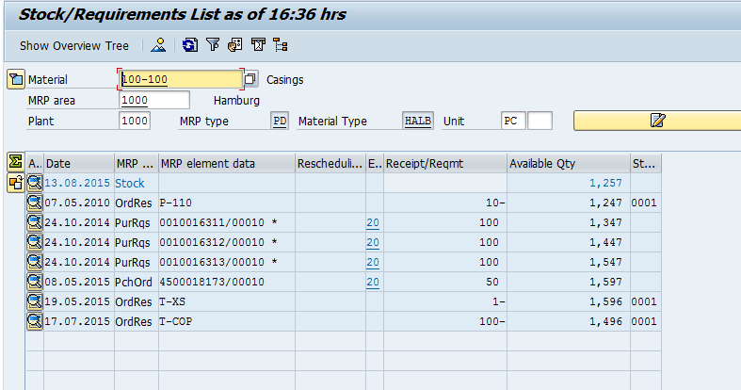
Stock Requirement List - Individual
Transaction Code
MD04: Stk Req List
MD07: Stk Req List Coll
MD05: MRP List
MD06: MRP List Coll
Notes:
Stock Requirement List – Individual displays the requirement list for a material in a Plant
Date reflects when a Material has been received or when a Material requirement exist
MRP Element indicates the type of document. Example: Order stands for Sale Order, Plord stands for Planned Order.
Each document can be also displayed directly from the Stock Requirement list
Vendor and Customer for Purchasing documents and Sales documents can also be displayed

Slide 62
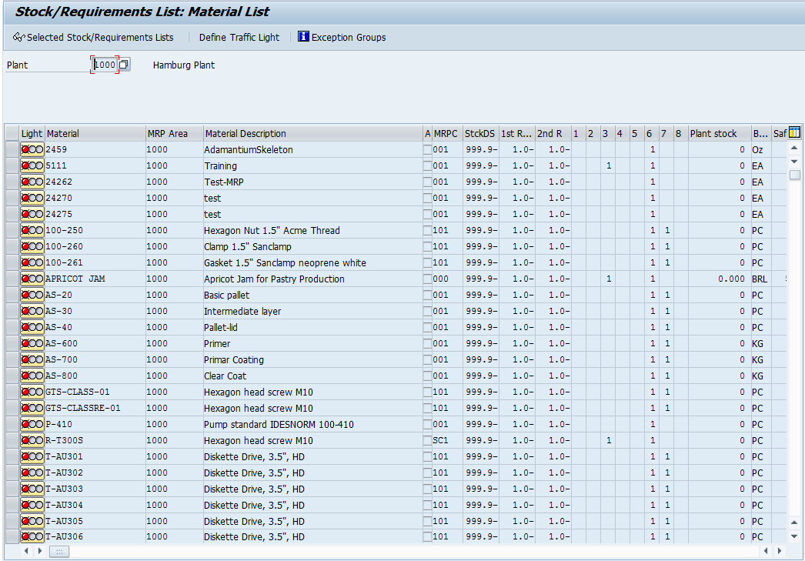
Stock Requirement List - Collective
Notes:
Collective List can be searched at MRP Controller or Product Grp level. The search can also be further limited at MRP date, Processing date, Days supplies, Exception group, Processing indicator & Material data
The selection criteria for collective access in the MRP lists are not the same as those in the current stock/requirements lists. Here, for example, the MRP or processing date and/or the processing indicator for the selection are available
Requirement List can be display for individual Material also
Traffic Lights displays the processing priority. Materials with Red Traffic light have the highest priority and with green has the lowest priority
Range of Coverage: Materials with the highest days supply are those with high stock level

Slide 63

Exception Message
Exception Message indicate:
  New order proposals created by MRP
  Dates in the past (start date, finish date or opening date)
  Problems during BOM explosion & Scheduling
Exception Message can be customized for
  Determining which exception message to be displayed if in the MRP List
  several exception messages are created
  Grouping of several exception message
Notes:
Exception messages depend on the procedure and indicate exceptional situations that have to be considered (for example, start date in the past, stock level falling below safety stock)
Exception messages are used to control the planning results. The MRP controller is able to select materials from the planning result that have to be processed manually

Slide 64
Consumption Based Planning
PrepareMe
1
2
TellMe
3
ShowMe
4
LetMe
5
HelpMe

Slide 65
LetMe
Identify and maintain MRP relevant fields in Material Master MRP View - 1
How can a planning file entry be displayed?
How can we check material/stock requirement for a plant?
At what level a re-order point is determined?
How can we carry out Single-item planning run?
How can we convert a Purchase Requisition into a Purchase Order?
What is the role of MRP controller?

Slide 66
Let Me
What is the relevance of Lot- size?
Where do we specify the minimum and maximum lot size?
Where do we specify type of procurement element to be generated by a MRP run?
Is it possible to control the selection of old procurement proposals in a planning run? If yes, then how?

Slide 67
Consumption Based Planning
PrepareMe
1
2
TellMe
3
ShowMe
4
LetMe
5
HelpMe

Slide 68
Additional Info
Lot size can be restricted by defining limiting values (minimum lot size & maximum lot size) in the Material Master – MRP 1 View. During lot-size calculation, the system takes into account these limiting values. That is, the lot size is either rounded up to the minimum lot size, or the system prevents the grouping of requirements to form more than the maximum lot size
Lot size can be restricted through Rounding Profile. The Rounding Profile helps the system to determine during lot-size calculation that the lot size quantity is a multiple of an order unit (for example, pallet size, if the material is only delivered in complete pallets)
User Exit can be used to restrict total planning run to certain material that fulfill freely definable criteria. Example:
  only materials planned using MRP
  only materials for a particular MRP Controller
  only materials procured externally or in-house

Slide 69
Additional Info
In the Stock Requirement & MRP list, user – specific settings can be customized. Customer exit are also available to show additional data in the Requirement planning
Main Transaction codes in Consumption Based Planning
Transaction | Activity
MD01 | Carry out total planning online
MD03 | Carry out single-item, single-level planning
MDBT | Carry out total planning in background mode
MD05 | Display MRP list
MD06 | Access collective display of MRP list
MDLD | Print MRP list

Slide 70
Additional Info
Transaction | Activity
MD04 | Display current Stock Requirement List
MD07 | Display collective display of current stock/requirements list
MD11 | Create planned order
MD12 | Change planned order
MD13 | Display planned order (individual)
MD16 | Access planned order (collective display)
MD14 | Convert planned order to purchase requisition (individual conversion)
MD15 | Convert planned order to purchase requisition (collective conversion)

Slide 71
Additional Info
Transaction | Activity
MD20 | Create planning file entry
MD21 | Display planning file entry
MDAB | Set up planning file entries
MDRE | Consistency check of planning file entries

Slide 72
Thanks & Question ?

